Slide 1
Friends of Nu Skin
Product Gift Store Options
Share products with our friends

Slide 2
Provide Product to Friends of Nu Skin
Allow staff to browse and order product
Ship product to offices
Bill back Gary
Limit product use to reasonable amount
Leaders and officials be identified
  Civic Leaders
  Religious Leaders

Slide 3
Account Questions
Account Granularity Choices:
  Set up an account for each staff member?
  Have each office share an account?
  Require Email address, Building location
Allotment Quantity Choices:
  Same as Employees each month or annually?
  Some other increased amount?
Frequency of Shipping:
  Weekly
  Monthly
  Quarterly

Slide 4
Available Store Options
 | A. Existing Store | C. New Store
Summary | New Customer group in existing store | New store for Friends of Nu Skin
Cost | $800 | $16,000 (+$1500 annual)
Time | 4 Days | 11 Weeks
View Product Pricing | Points & Employee Discount | Any you want
Fulfillment | Store (periodic Ship) | Any you want
Products Included | Employee Store/ Payroll Deduction | Any you want
Look and Feel | ProductLove, view Employee Policies | Any you want
Accounts | Either staff or office level | Any you want

Slide 5
Appendix Material - Screens
Login
Home
Products
Checkout

Slide 6
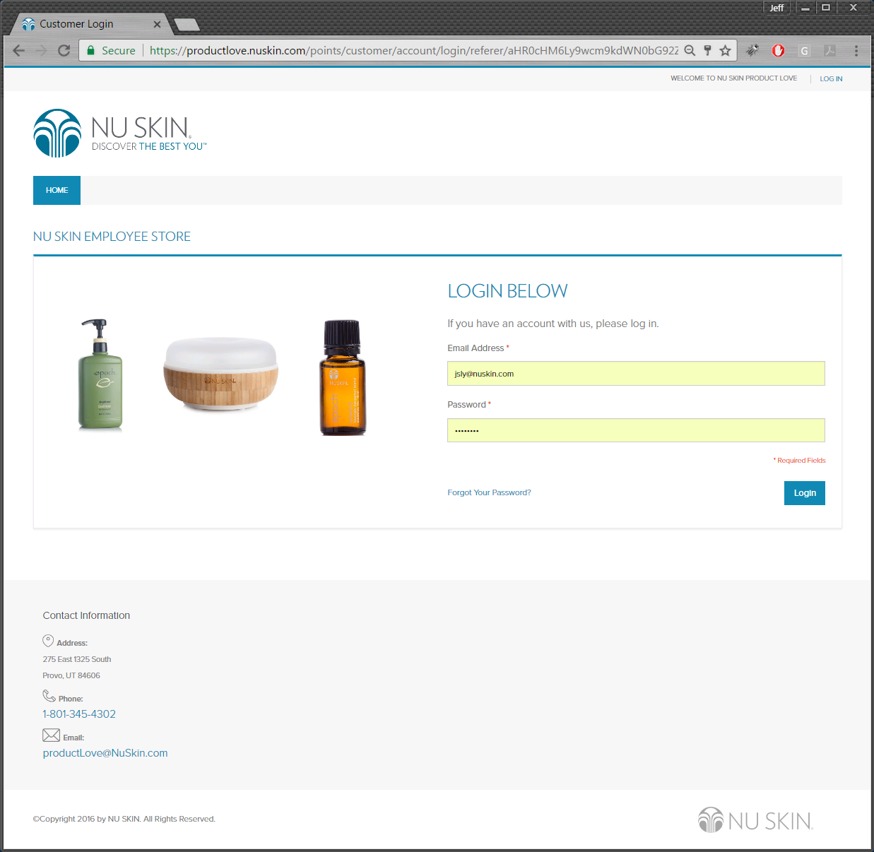

Slide 7
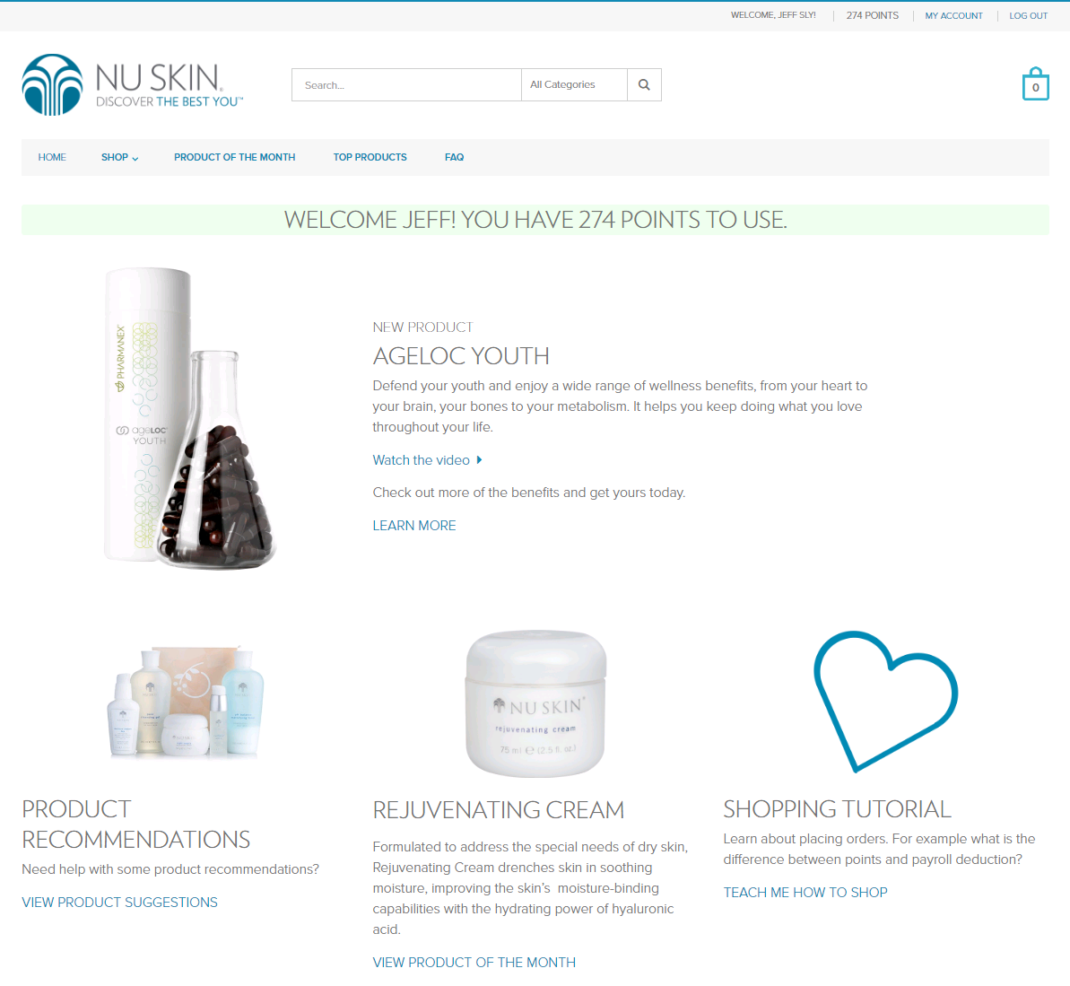

Slide 8
